Slide 1
Shannon Inspired Approach to Limits of Learning
FunLoL Kickoff Meeting
October 28, 2016

Slide 2
Elements of Learning
Some underlying elements of learning are:
Learners and their characteristics
Concept to be learned
Tutor (if any) and its characteristics
Other important factors are
Objectives of learning
Prediction
Modeling/Presentation
Inference
Repeating a task
Decision Making
Receiving rewards
Method of learning

Slide 3
Motivation

Slide 4
Motivation
Suppose we are given some data.
How much can we learn from the data?
Is there a theoretical limit?
Example: We drop a metal ball initially at rest from elevations h₁, h₂, …, h_{n} and record the respective velocities v₁, v₂, …, v_{n} at impact with ground.
What do we learn from repeating the experiment an (n+1)-th time?
How much information does repeating the experiment provide?
Is the unit of this information (if any) bits?

Slide 5
Motivation
If we know that Newtonian mechanics is correct (say using a tutor) and equal to the absolute physical truth, then v² = 2gh.
Repeating the experiment (or even doing the experiment at all) will not provide any new “information”.
But if there is a slight chance that Newtonian mechanics is not equal to the truth, is it worth repeating the experiment?
Can the right experiment change our model at all?
Can we find the true physical model for this experiment?
Is there a true model at all?
Would we care (for practical engineering) if the model is incorrect?
Depending on the application (objective of learning) it may not be worth doing new experiments/improve the model.
Thus the “information” may depend on the learner objective.

Slide 6
A Starting Model

Slide 7
A Model
We propose an approach to understanding/defining the “learning limits”.
Suppose that the learner wants to learn a learning concept f(.) e.g. v² = 2gh (assuming it is the truth)
Let us assume that the learner is able—i.e. not limited in making observation
The learner observes x₁, x₂, …, x_{n} of an instance space X.
A limited learner may receive an altered observation of x₁, x₂, …, x_{n}.

Slide 8
A Model
The learner further observes pairs
(x₁ , f(x₁)) , (x₂ , f(x₂)) , ….. , (x_{n} , f(x_{n}))
Let y_{i} = f(x_{i}) for i=1, 2, ...., n.
The learning concept f can be probabilistic (i.e. f can be random as in statistical learning) or deterministic.
If random f can be thought of as p(y_{i} | x_{i}).
x₁, x_{2,} ….., x_{n} can be deterministic or random (with some distribution p(x) ).
The learner does not know f(.) (and p(.) in probabilistic case) or may have some side information i.e. provided by a tutor.
It is next presented with x_{n+1} and would like to estimate y_{n+1} = f(x_{n+1} ) (or the most likely value of y_{n+1} if the setting is statistical.

Slide 9
A Model
This framework clearly contains both approximation theoretic and statistical approaches to learning.
We first assume that the learning function f lives in a concept universe space W that has a filtration given by
with the closure of the union (with respect to some norm) of V_{k} for k=1,2,3, … equals (or is a subset of) W.
For instance if f is a continuous function in [0,1], then V_{k} may be the span of all polynomials of degree k and norm can be L∞.
In general, similar filtration may exist for other function classes with other norms (e.g. L² norm).

Slide 10
The Proposed Approach
Within this framework:
The learner first searches sequentially in the set V₁ for a concept function by observing (x₁ , f(x₁)) , (x₂ , f(x₂)) , ….. , and (x_{i} , f(x_{i})) and trying to estimate f() for i=1,2, ….
After the improvements in estimating f() in class V₁ becomes small (in a sense to be described here) or if V₁ can be rejected, then the learner may start searching in V₂ (looking for new theories)
It may continue in this manner by moving from V_{k} to V_{k+1} until either the training data ends, or the gains of going to higher values of j becomes small as compared to added description complexity (will be discussed later on)
In principle, we hope to be able to learn the concept f( ) to any good accuracy if and we have enough data available.

Slide 11
Philosophical Discussion
We can see that humans learn in the same manner.
They first choose a concept from a perceived set of hypothesis/theories and create a hypothesis/theory.
Then based on more observations, the humans refine their theories (or reject them).
What humans learn then depends on the set W of all concept potentials, the filtration
and method of refinements.
It is possible that these sets/filtrations change with time (which we will investigate).
It is also possible that the learner may not be fully able (e.g. blind to a subset of the instance space X)

Slide 12
Limits of Learning within V_{k}
We now focus on learning algorithms within V_{k.}
We will develop some models and propose methods to understand these limits.
As discussed before values x₁, x_{2,} ….., x_{n} of are in instance space X.
We assume that there is a distribution P_{k}(.) on V_{k} (could be given for instance by a tutor) for the concept s in V_{k} to be the right model with in V_{k}.
There is also an induced distribution Q_{k,n}(.) on V_{k} that gives the perceived distribution of true concepts in V_{k} up on observations.

Slide 13
Limits of Learning within V_{k}
The probability distributions P_{k}(.) and Q_{k,n}(.) must be related to those of P_{k+1}(.) and Q_{k+1,n}(.).
Suppose that (x₁ , f(x₁)) , (x₂ , f(x₂)) , ….. , and (x_{n} , f(x_{n})) are observed for some n.
The learner’s Shannon uncertainty for estimating the concept f( ) may be of interest to the learner.
In this case, the information that the learner has obtained by observing (x_{n+1} , f(x_{n+1})) is given by:
This may be defined to be the limit of learning from data x in the concept space V_{k} when minimizing uncertainty.
There is another information that we may learn and that comes from learning the “right k”.
Can we add these two information values and call it the limit of learning from the data?

Slide 14
Limits of Learning within V_{k}
The objective of the learner need not be the uncertainty in the concept f() and is generally .
Then, the improvement in the objective of the learner that is obtained by observing the (x_{n+1} , f(x_{n+1})) is given by
which does not necessarily satisfy all of the nice properties of entropy.
The learner must explore the concept space V_{k+1} when the improvement in its objective becomes small in V_{k} or when V_{k} “can be somehow rejected”.
How much information data provides about k relates to model matching.

Slide 15
Limits of Learning for k

Slide 16
General Objective of Learning
General estimator:
Supervised learning examples:
Function approximation (linear regression)
Training of a neural network
Unsupervised learning examples:
Hierarchical clustering
K-nearest neighbors clustering

Slide 17
General Objective of Learning
General estimator:
Selection among models depends on the objective of the learner
One approach: minimize the out of sample error
model complexity
test
data
training
data

Slide 18
Selecting Optimal V_{k}
training samples

Slide 19
Selecting Optimal V_{k}
least squares
training samples
target function

Slide 20
Selecting Optimal V_{k}
fitted polynomial of degree 0
training samples
target function

Slide 21
Selecting Optimal V_{k}
fitted polynomial of degree 1
training samples
target function

Slide 22
Selecting Optimal V_{k}
fitted polynomial of degree 2
training samples
target function

Slide 23
Selecting Optimal V_{k}
fitted polynomial of degree 3
training samples
target function

Slide 24
Selecting Optimal V_{k}
fitted polynomial of degree 4
training samples
target function

Slide 25
Selecting Optimal V_{k}
fitted polynomial of degree 5
training samples
target function

Slide 26
Selecting Optimal V_{k}
fitted polynomial of degree 6
training samples
target function

Slide 27
Selecting Optimal V_{k}
fitted polynomial of degree 7
training samples
target function

Slide 28
Selecting Optimal V_{k}
fitted polynomial of degree 8
training samples
target function

Slide 29
Selecting Optimal V_{k}
fitted polynomial of degree 9
training samples
target function

Slide 30
Selecting Optimal V_{k}
fitted polynomial of degree 10
training samples
target function

Slide 31
Selecting Optimal V_{k}
In sample error

Slide 32
Selecting Optimal V_{k}
Out of sample error
Generalization error
In sample error

Slide 33
Selecting Optimal V_{k}
Out of sample error
Estimate of out of sample error
Generalization error
In sample error

Slide 34
Optimal V_{k}
fitted polynomial of degree 3
training samples
target function

Slide 35
Akaike Information Criterion
What we can estimate from data:

Slide 36
Akaike Information Criterion
What we can estimate from data:
Akaike derived the generalization error for ML estimator, i.e.,
Out of sample error
In sample error
Generalization error

Slide 37
Least Squares Objective
Solution:
least squares objective
Basis functions evaluated at observed samples

Slide 38
General Objective of Learning
General estimator:
Selection among models depends on the objective of the learner
One approach: minimize the out of sample error
model complexity
test
data
training
data

Slide 39
Generalization Error for General Objective of the Learner
Out of sample error for the objective of learner:
where
Generalization error
Hessian
Covariance of the estimate

Slide 40
Estimation of Generalization Error
Out of sample error (equivalent form):
where
Generalization error
Hessian
Generalized score covariance
generalized score vector

Slide 41
Limits of Learning for k
It is known that various information criteria have a Bayesian interpretation where the generalization error term could be cast as a prior on the model complexity k. [Anderson ‘02]
We will investigate the prior induced by the general objective of learning on the model complexities and how it would be sequentially updated by acquiring more data samples.
We also investigate the aggregation of any prior knowledge that the learner might have at his disposal provided by the tutor to him into this framework.
We will investigate the calculation of the limits of learning (e.g., Shannon entropy) subject to the derived prior on k and the concepts within V_{k}.

Slide 42
Limits of Learning for Score Matching
Information criteria are well studied when the objective of the learner is to maximize the likelihood of the chosen concept.
There are several other problems in which MLE is known to be suboptimal or hard to compute.
We will calculate the limits of learning and information criteria for other practically motivated M-estimators, such as score matching estimator [Hyvarinen ’06].

Slide 43
Connections to Cross Validation
Various Information criteria e.g. FPE are known to be asymptotically equivalent to the leave-i-out cross validation [Stone ’77, Shao ‘97].
On the other hand, practitioners usually prefer cross validation over theoretical estimation of the generalization error because of the outliers in the data sets.
We will theoretically investigate the connections of the model selection based on the general objective of the learner with leave-i-out cross validation for all 0<i<n.

Slide 44
Other Issues
We will extend our results and investigate limited learners (similar to Cascade channels in Shannon Theory) and compute the learning limits.
Depending on the application, the leaner may not even care if the model is identifiable.
How do we extend the definition of identifiability with respect to the objective of the learner?
Finale will discuss this issue.
But first we give an example (if we have time).

Slide 45
Example

Slide 46
Example: Quadratic Objective
Solution:
General quadratic objective
Basis functions evaluated at observed samples

Slide 47
Selecting Optimal V_{k}
training samples
target function

Slide 48
Selecting Optimal V_{k}
In sample error

Slide 49
Selecting Optimal V_{k}
Out of sample error
Generalization error
In sample error

Slide 50
Selecting Optimal V_{k}
Estimate of out of sample error without considering the objective of the learner
Out of sample error
Generalization error
In sample error

Slide 51
Selecting Optimal V_{k}
Estimate of out of sample error with considering the objective of the learner
Estimate of out of sample error without considering the objective of the learner
Out of sample error
Generalization error
In sample error

Slide 52
Selecting Optimal V_{k}
fitted polynomial of degree 3
fitted polynomial of degree 16
training samples
target function

Slide 53
Identifiability

Slide 54
Addressing Non-Identifiability
So far: focused on limits of prediction
Now: a different kind of limit—identifiability
Research questions:
Can we characterize non-identifiability in common machine learning models?
How can we search for alternate parameter settings of (almost) equal quality?

Slide 55
Probabilistic Setting: Many regions may give the same p(x|θ) or p(x,θ)
θ

Slide 56
Probabilistic Setting: Many regions may give the same p(x|θ) or p(x,θ)
How can we find
these regions?
θ

Slide 57
First: This is a real problem!Nonnegative Matrix Factorization
We have an D by N data matrix X that we wish to approximate with a low rank decomposition
where A ≥ 0 is a D by K basis matrix and W ≥ 0 is an K by N weight matrix.
D
N

Slide 58
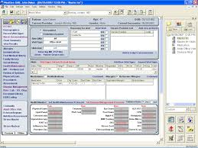

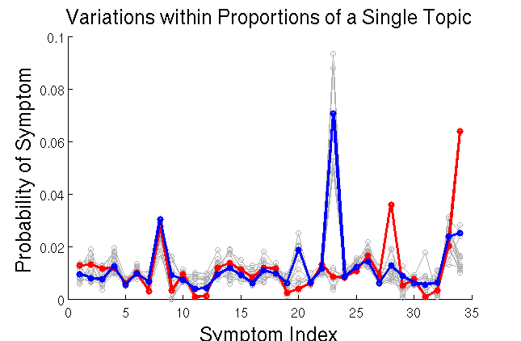
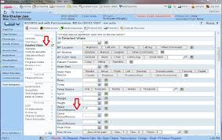
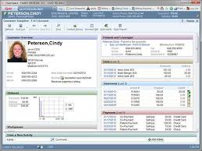
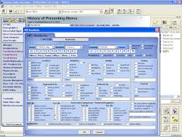
First: This is a Real Problem! Nonnegative Matrix Factorization

Slide 59
How can we find these θ?
Framework: (Online) Nonparametric Variational Inference (following Gershman et al. 2012)
Approximate our true distribution p(θ|x) with q(θ), where q(θ) is mixture of Gaussians { (w_{m}, μ_{m}, σ²_{m}) }
Note that adding a mixture component can only improve the KL (more flexible distribution for q).
Can we intelligently propose components?

Slide 60
Locations for the Centers
For different modes: start with multiple random restarts to find an initial collection {(A,W)}.
Expand from each via a rapidly-exploring random tree (RRT).
Apply the RRT in the oblique manifold over Q from {([AQ],[Q⁻¹W])}

Slide 61
Locations for the Centers
For different modes: start with multiple random restarts to find an initial collection {(A,W)}.
Expand from each via a rapidly-exploring random tree (RRT).
Apply the RRT in the oblique manifold over Q from {([AQ],[Q⁻¹W])}

Slide 62
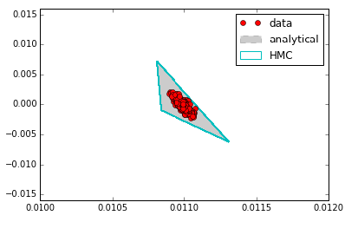
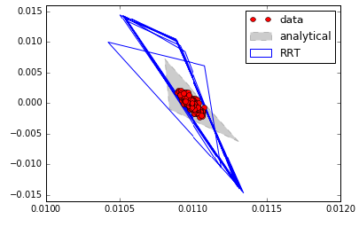
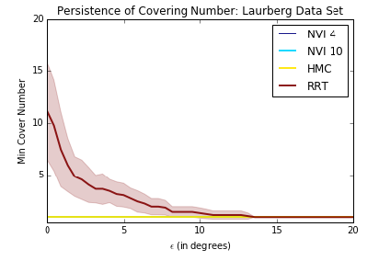
Results: Synthetic Data

Slide 63
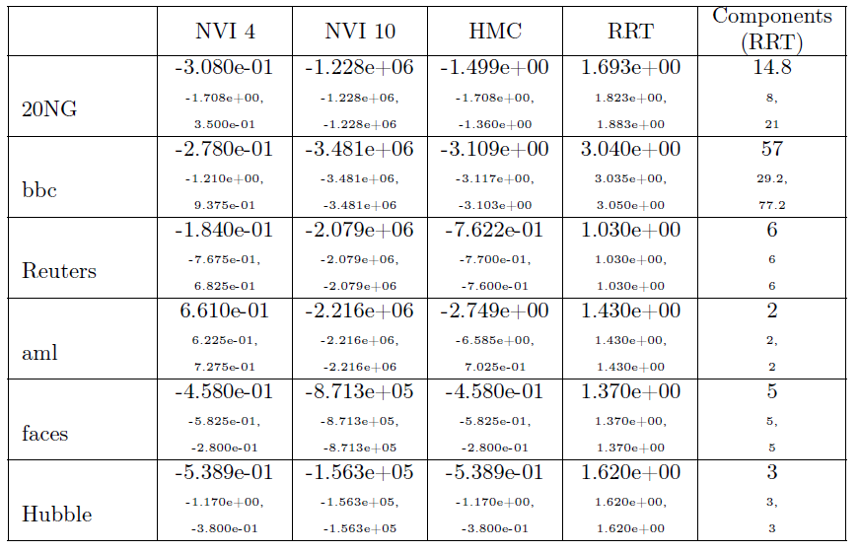
Results: Real Data

Slide 64
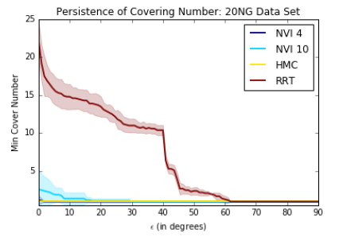
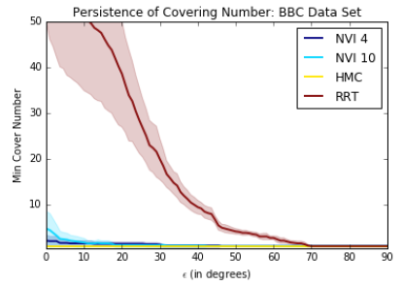
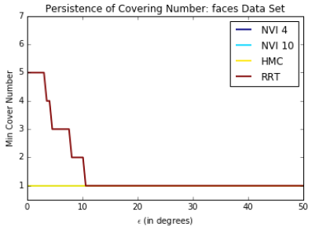
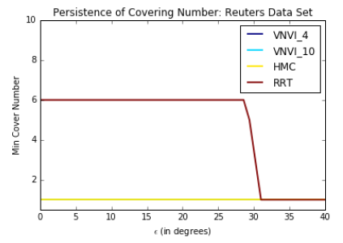
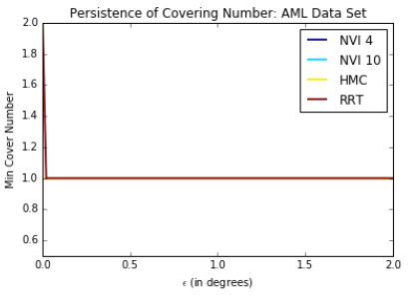
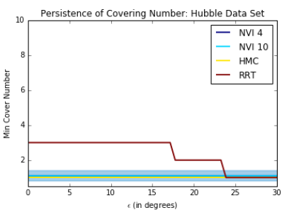
Results: Real Data

Slide 65
Summary and Future Directions
Characterizing unidentifiability of models is critical in scientific applications in which model parameters are interpreted for meaning. For NMF, we have a complete characterization of unidentifiability.
Applying exploration algorithms seem to be a promising approach to help find alternate parameter settings. More to come!

Slide 66
Thank You

Slide 67
Back-up Slides

Slide 68
Algorithmic Learnability
Kolmogorov approach is the holy grail of all approaches to determining learnability.
Although, it is algorithmic but for classes of random sequences, it reduces to information theoretic limits of compression (e.g. Shannon’s limit).
These have motivated both classes of algorithmic and random learnability measures that mimic Kolmogorov’s idea.
Examples of Algorithmic Learnability Measures are:
Minimum Description Length (MDL)
Not practical for reasonable size sequences
Language Learning in the limit (Proposed by Gold)
Not easy to implement in practice

Slide 69
Probabilistic Learning
An approach to learning is based on probabilistic models, i.e. Statistical Learning. The learning can be supervised, unsupervised or semi-supervised. It can be online or batch. The methods can be based on stochastic control (reinforcement learning), etc. A typical setting is given below:
Let X and Y respectively denote the vector space of all possible inputs and outputs.
It is assumed that there is an unknown probability distribution over the product space X × Y.
There is a training set (x_{i}, y_{i}) , i=1,2,…,n of samples from this probability distribution.
For any function f_{θ}: X → Y, we define the Loss function L(f_{θ}) as the E(d(f_{θ}(x), y)) where d(.,.) is a distance function in Y.
The learning could be finding f_{θ} ( ) in a given function space or class V to minimize the loss.

Slide 70
Probabilistic Learning
Typical loss functions are the L² and L¹ norms and indicator functions.
A regularization term can be added to the loss in some cases as well.
Now if the loss is the error of indicator function of classification error into two (or more classes), then for instance Vapnik-Chervonenkis Theory may apply.
This more or less says that if the VC dimension is small, then the minimum class empirical risk (calculated at the observation) converges to minimum class risk with rate (log n/n)^0.5.
Thus the minimum class risk in this setting is learnable.

Slide 71
Neural Networks
This approach to learning is motivated by approximation theory.
It can be proved that the set of linear combinations of perceptron functions are dense in L².
Thus it must be possible to estimate any classifier in L² by neural networks with arbitrary accuracy.
The above dense approximation property implies as a corollary the following universal approximation result: The Bayes classifier in statistical learning in the feature space can be approximated arbitrarily well by networks of formal neurons .
Of course, for better approximation, more neurons are needed.
This fact may tempt the unwary practitioner to increase the size of the network to be used for classification.
However, one should proceed with care. A large network has many tunable parameters all of which must be learned from a fixed amount of training data. Thus one may easily run into the problem of overfitting , that is, the resulting classifier will perform very well on the data but no generalization will take place.

Slide 72
Neural Networks and VC dimension
If the learning model is statistical and the Bayesian classifier is to be estimated by a neural network, then the VC dimension of functions in the span of neural networks becomes relevant.
One can compute the VC dimension of single layer and multilayer acyclic neural networks.
In particular, based on the results found in the literature, it has been concluded that [1] shallow networks (with dense interconnectivity) are computationally more efficient than deep networks.
However, this is found to be empirically incorrect in recent years (Deep Learning).
Thus it seems that the analysis provided by VC dimension is too pessimistic.
[1] P. Baldi and S. S. Venkatesh, “On properties of networks of neuron-like elements,” in Neural Information Processing Systems, D. Anderson, Ed. New York: Amer. Inst. Phys., 1988.

Slide 73
Limits of Learning
Thus, we have seen that most of the mathematical results related to learnability are
Hard to compute (e.g. Kolmogorov complexity), implement, or of little practical interest.
Based on approximation theory (e.g. Neural Networks with training data) in this case the size of data plays a key role in limits of learning and generalizability.
Statistical (with training data): Limits are set based on (VC dimension) bounds which may be too conservative.
Also they mainly assume that the learner has
Infinite computational resources
Infinitely able learners
There are no malicious tutors or tutors with lack of knowledge.

Slide 74
Fortunately, we have many results on when NMF is identifiable!
Donoho and Stodden (2004): Separable Complete Factorial Families
Laurberg et al. (2008): Given a factorization, decomposition has “Sufficiently Spread” and “Boundary Close” properties.
Huang et al. (2014): Certain patterns of sparsity
Anandkumar et al. (2012), (2014), Arora et al. (2011), Ge et al. (2015): coherence, anchor words, faces

Slide 75
A Different Approach: How can unidentifiabiliy happen?
In the case of exact NMF, we show that unidentifiability occurs in one of three ways:
Type I
Type II
Type III

Slide 76
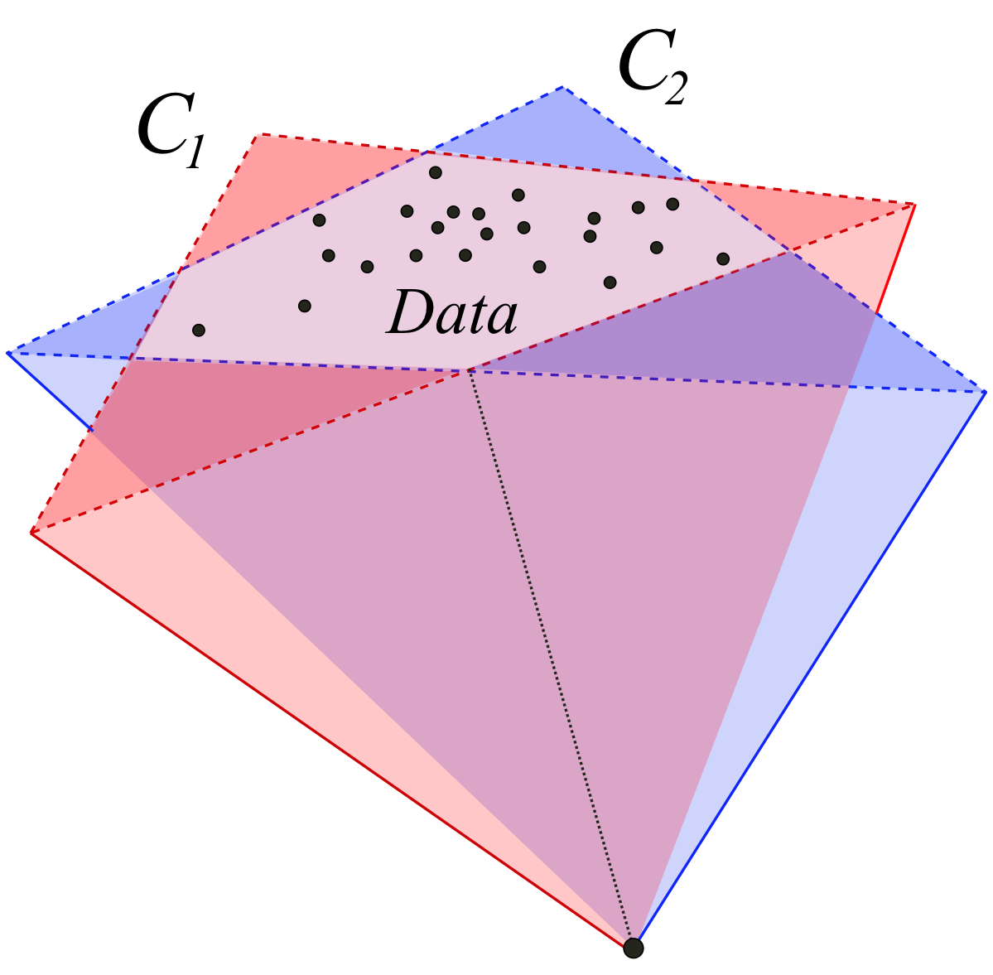
Type I: Same Subspace
Only kind of unidentifiability possible if
rank+(X) = rank(X)

Slide 77
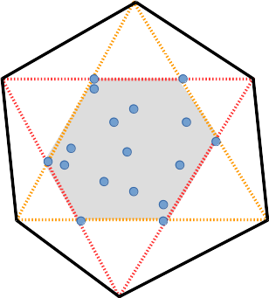
Type I: Same Subspace
If we choose
From Laurberg et al. (2008)

Slide 78
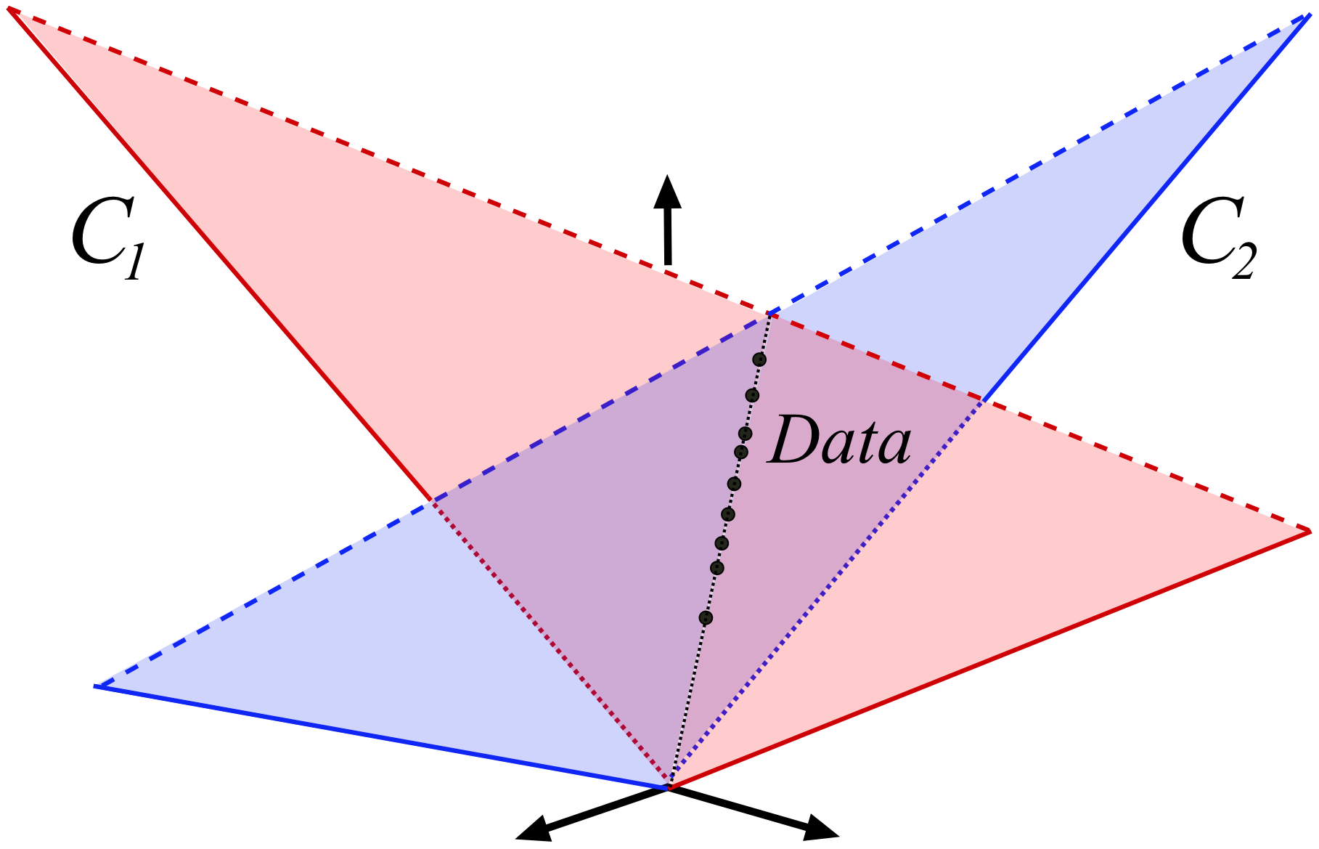
Type II: Different Subspaces
Only possible if
rank+(X) > rank(X)

Slide 79
Basics: “Trivial” Unidentifiability
Monomial Matrices: Combinations of scaling and permutation

Slide 80
Type II: Different Subspaces
Only can occur if
rank+(X) > rank(X)

Slide 81
Type II: Different Subspaces

Slide 82
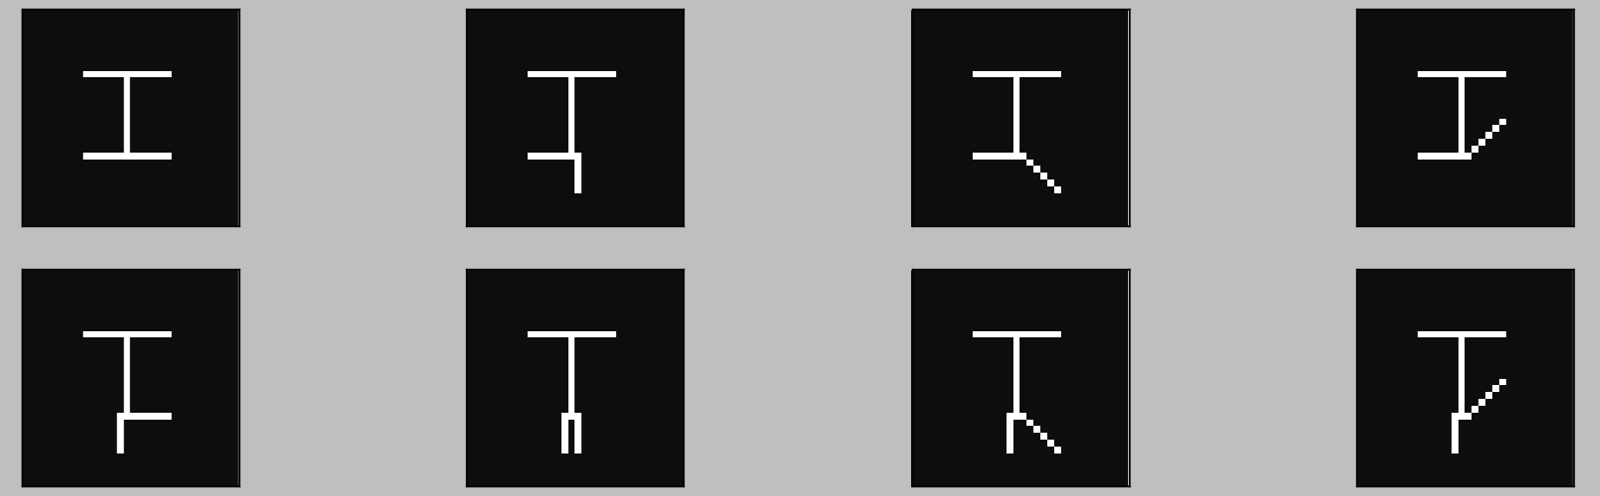
Type II: Different Subspaces

Slide 83
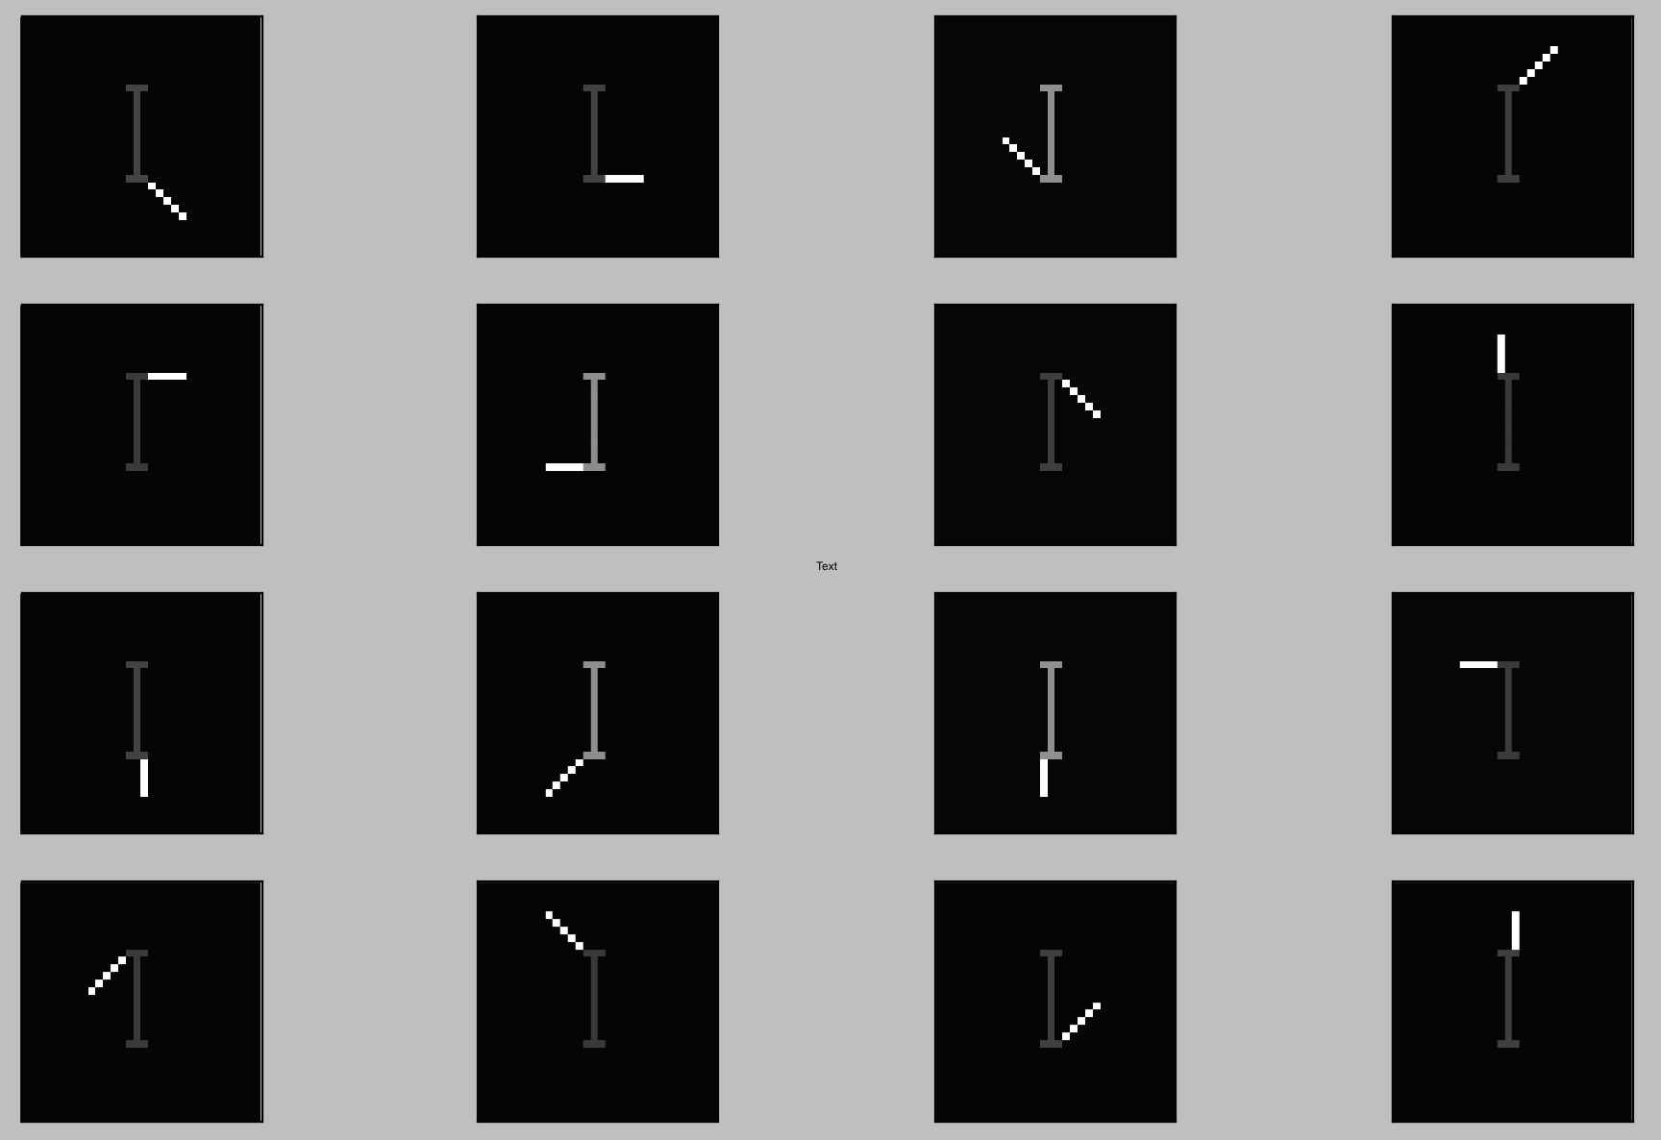
Type II: Different Subspaces

Slide 84
Type III: Both Combined

Slide 85
Type III: Both Combined
Solution is unique in col(A)
Infinite solutions in a different subspace!

Slide 86
Proposed Metric: Covering Number

Slide 87
Proposed Metric: Covering Number

Slide 88
Proposed Metric: Covering Number

Slide 89
Proposed Metric: Covering Number

Slide 90
Proposed Metric: Covering Number
Clusters
Epsilon

Slide 91
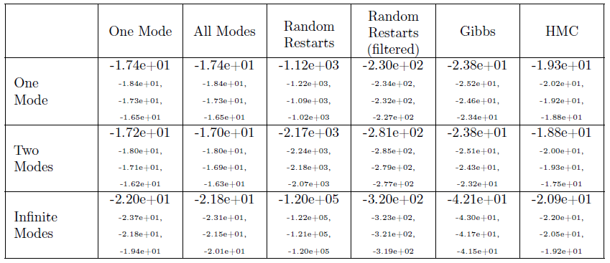
Covering Number in Action
Likelihood

Slide 92
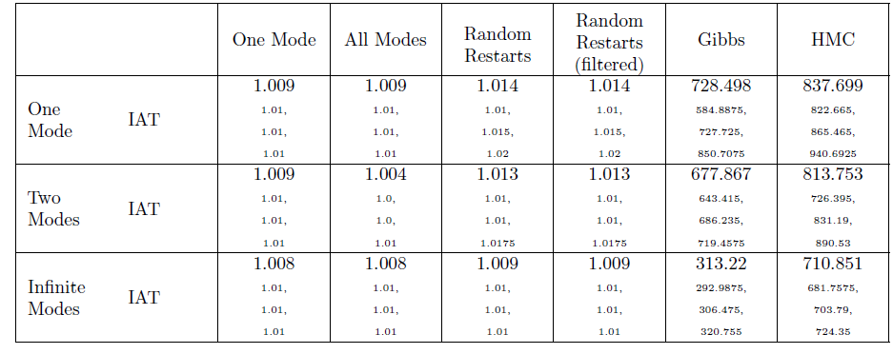
Covering Number in Action
Likelihood
IAT

Slide 93
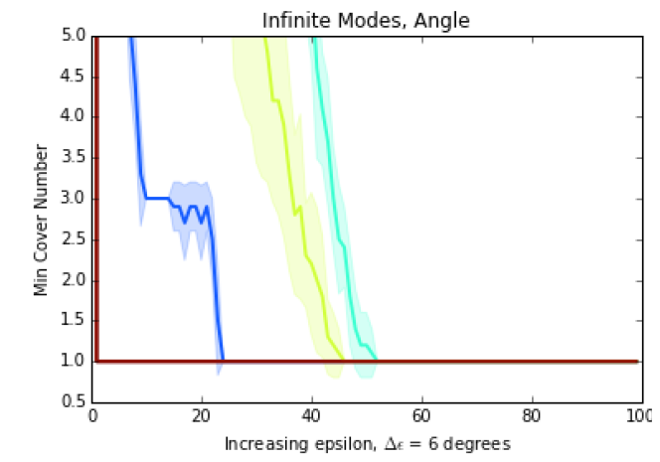
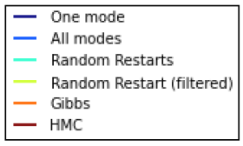
Covering Number in Action
Likelihood
IAT
Persistence Plot

